Slide 1
Bowtie Risk Visualization
Group 1

Slide 2
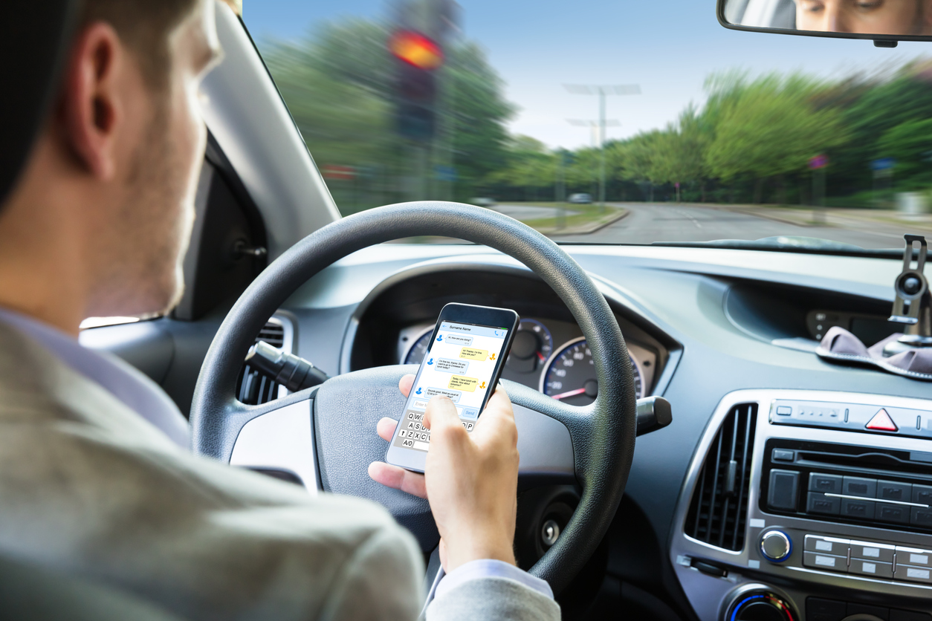
Why this risk scenario matters
Who This Helps
Fleet Managers
Executives
Drivers
Who This Affects
Drivers & passengers
Fleet operations
The company
Why It’s Important
One distraction can trigger a full loss-of-control event
Small threats → big consequences when barriers fail
Notes:
Suggested title: Every major incident starts as a small, preventable threat.

Slide 3
Live Demo
https://www.figma.com/proto/IBNZQZDxOxZsC7wUhDKD6z/cjapit-s-team-library?page-id=0%3A1&node-id=3328-687&viewport=-2284%2C2923%2C2.02&t=Q8K8HfglpGqUGDSx-1&scaling=min-zoom&content-scaling=fixed&starting-point-node-id=3328%3A687

Slide 4

Design Choices (Chris)
Threats -> Barriers -> Top Event -> Barriers -> Consequence
Spacing
Colors
  Red: Barrier Fail
  Green: Barrier Active
  Orange: Downstream Flow
Legend
  Threat / Barrier (Active / Passive) / Hazard / Top Event / Consequence

Slide 5

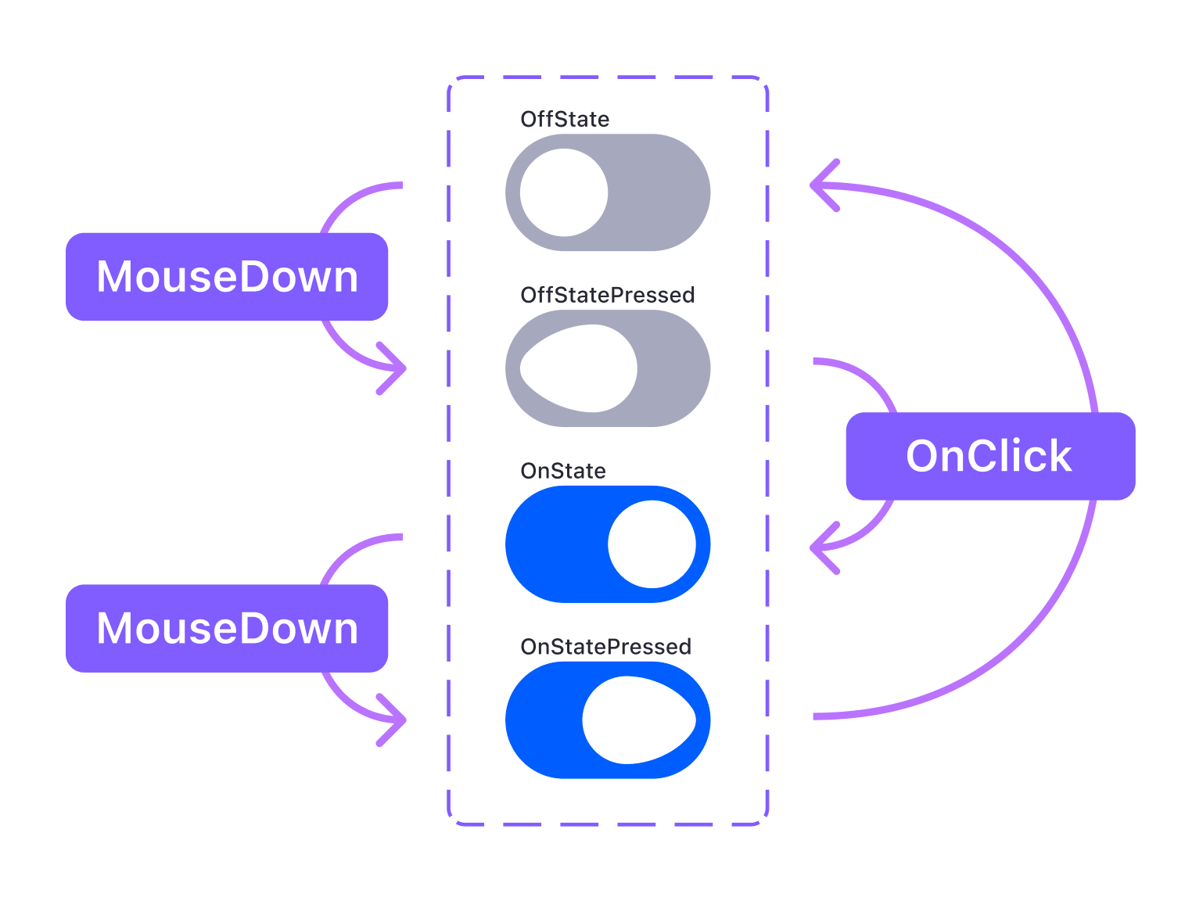
Prototype Logic
Components
  Simulation of interactivity
  Variants
Interactivity
  Triggers
  Actions
  Animations

Slide 6
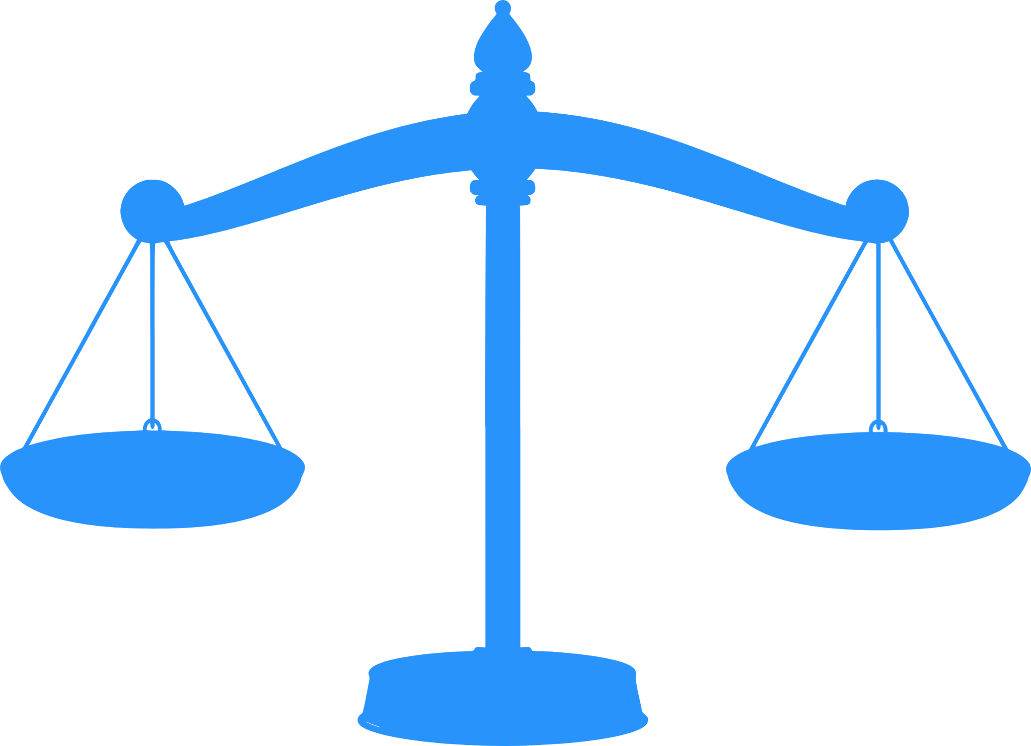
Trade-Offs (Figma vs Reactflow)
Speed
  Implementation
Accessibility
  No coding required
Collaboration
Scalability
  Easier to manage
Performance
Functionality

Slide 7
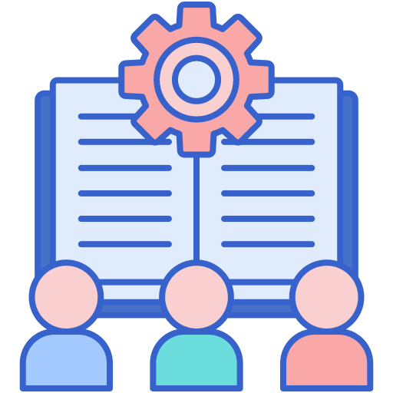
Lessons Learned
Improvements
Importance of interactivity
Audience matters
Clarity vs Detail

